Slide 1
Note for educators
You know your students best. The following slides are created to support a
secondary social studies class around a 9th grade level.
Please feel free to adapt these slides and materials to best fit your students.

Slide 2

Activity 2
My water use

Slide 3

Learning Objectives
Students will be able to calculate their own water use in a day.
Students will be able to determine different ways to reduce their water use.
Students will compare how water is used in the United States and
other parts of the world.

Slide 4
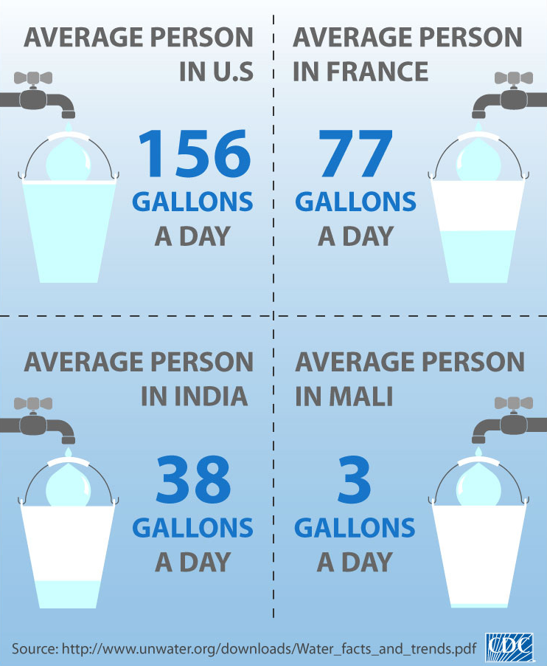
How much water do Americans use?
The chart on the right is about direct water use. This refers to all the activities that we do as individuals that actively use water (i.e., think turning on a tap).
The U.S. uses a large amount of water each day compared to other countries.

Slide 5
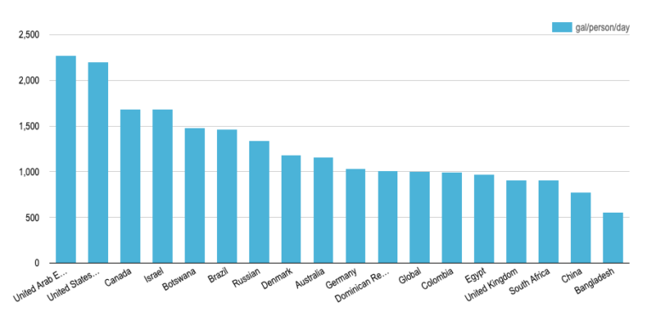
Fresh water use per person per day (gallons)
This bar graph presents indirect water use. This number is higher because it includes the water used to produce, grow, or manufacture the items we use every day.
Wow! More than 2,000 gallons a day
This is all fresh, drinkable water
Source: https://www.watercalculator.org/footprint/water-footprints-by-country/

Slide 6
Discussion
What are some ways you directly use water?
What are some ways you indirectly use water?
(Think about the things you use or need.)
Why do you think water use (both direct and indirect) in the United States
is so high compared to other countries?

Slide 7
How much water do you use in a day?
Follow the instructions on the worksheet to get an estimate of your direct water use.
What are the three daily activities you do that directly use the most water?
Are any surprising?

Slide 8
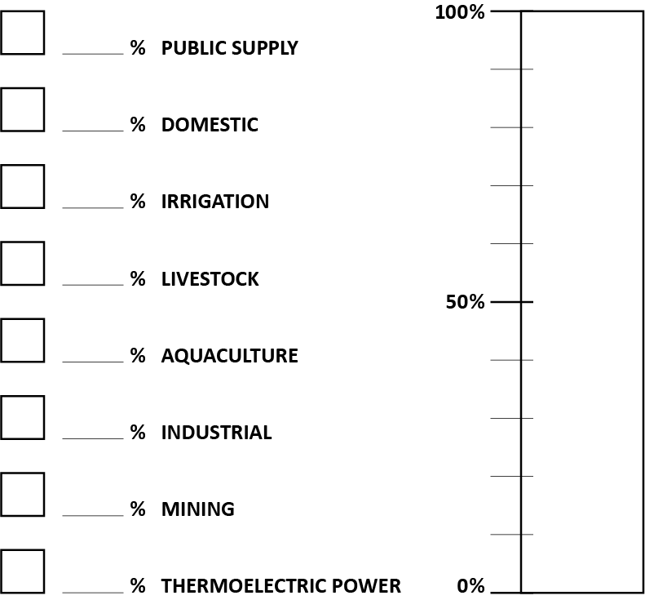
Indirect water use worksheet
How much water is used by different sectors?
Discuss with your group what percentage of total water use you think each sector uses. Record the numbers on your worksheet.
Then use a colored pencil to assign each sector a color. Shade in the bar with the different colors.

Slide 9
Reflecting on water use
How was your group’s guess compared to the actual water use?
Which areas were more than you expected? Which were less?
Why is it important to reduce water use in the United States?
Which of the ways that water is used in the United States could you influence?
In what ways could you influence them?

Slide 10
Final reflection
How can you (or your family, or your community) reduce your water use?
Which actions would be most effective? Use evidence from your two worksheets
to help make that decision.

