Slide 1
Note for educators
You know your students best. The following slides are created to support a
secondary social studies class around a 9th grade level.
Please feel free to adapt these slides and materials to best fit your students.

Slide 2

Activity 3
The problem with poo

Slide 3

Learning Objectives
Students will be able to explain why it is important to safely treat human waste.
Students will be able to evaluate their own design of a water filtration system.
Students will be able to explain some of the challenges associated with
sewered sanitation.

Slide 4
Simulated wastewater (influent)
Observe the simulated wastewater before filtration.
Record a description on at the top of your worksheet.
What color or texture does it have?
How does it look? Is it cloudy?
How does it smell?

Slide 5
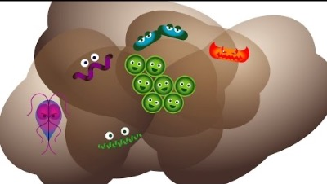
What is in your poo?

Slide 6

What is in your poo?
In a half jar of feces, there could be…
  200 trillion rotavirus particles
  20 billion Shigella bacteria
  100,000 parasitic worm eggs
BILL GATES
JAR OF
POO

Slide 7

Create a wastewater filter
You have many materials available to you to construct a filter. Layer your materials but remember to leave space at the top so there is enough room to add water.
Illustrate and label your layers on your worksheet.
Read the instructions on your worksheet carefully!

Slide 8
Filtered wastewater (effluent)
Observe your filtered wastewater after filtration.
Record a description on your worksheet.
What color or texture does it have?
How does it look? Is it cloudy?
How does it smell?

Slide 9
Results Comparison
Observe the filters that were created by other groups and the effluent that came out of them.
Which filters seem to have worked best? Why do you think that is?

Slide 10

Wastewater treatment

Slide 11

Wastewater treatment

Slide 12
When sewers go wrong
Whose responsibility is it to care for sewer systems?
How should our communities address the different issues with sewers?
What role could we each play as individuals?
Do we have a responsibility to take action? Why or why not?

Slide 13
Final reflection
What were the characteristics of the most effective water filters?
What in general worked the best?
Why is it important to safely treat human waste (poo)?
What are some challenges that occur with sewered sanitation systems?

