Slide 1
Note for educators
You know your students best. The following slides are created to support a
secondary social studies class around a 9th grade level.
Please feel free to adapt these slides and materials to best fit your students.

Slide 2

Activity 4
Reinventing the toilet

Slide 3

Learning Objectives
Students will be able to explain why it is important to “reinvent the toilet.”
Students will be able to brainstorm their own reinvented toilet design inspired by a household object.
Students will be able to compare the strengths and weaknesses of different reinvented toilet designs.

Slide 4
Let’s consider poo…
Problems with poo
Good things about poo

Slide 5


Slide 6
What is a reinvented toilet?
Reinvented toilets…
  Remove disease-causing agents, including viruses and bacteria.
  Recover valuable resources like energy, clean water, and nutrients.
  Operate “off the grid” without connections to water and sewers and require minimal electricity.
  Are very low cost (less than US$.05 cents per user per day).
  Promote sustainable sanitation businesses, especially in communities with little access.
  Are designed to be something anyone would want to use.

Slide 7

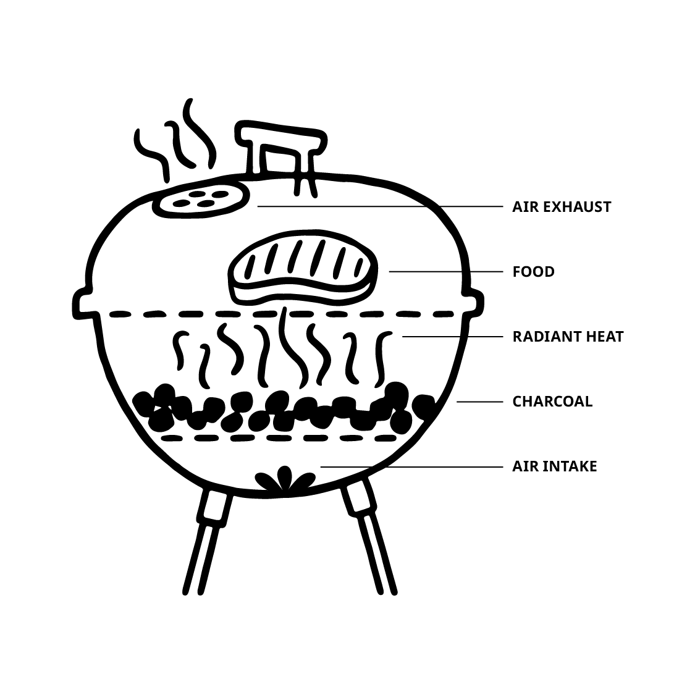
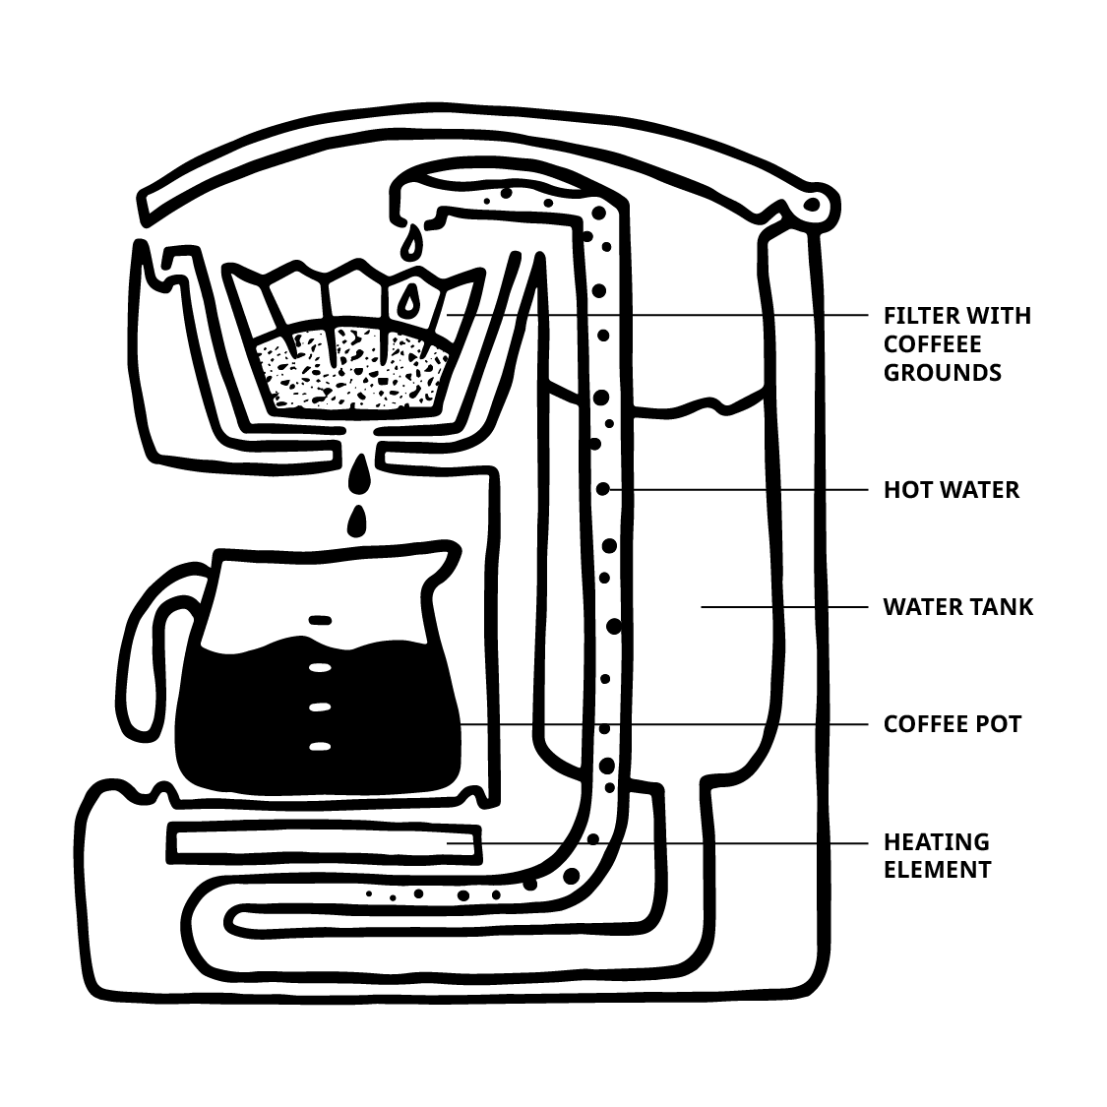
Choose an inspiration
Pressure Cooker
Barbecue
Coffee Maker

Slide 8
Brainstorm your toilet machine
How will you make sure what comes out of the toilet is safe and will not spread disease?
What resources (energy, clean water, nutrients/fertilizer) will your toilet machine provide to users?
How will it do that?
How will you power the machine without electricity? How will you move waste through the
machine without water?
How will you keep the cost of the machine low?
How will you make sure the machine meets the community’s needs and continues to be used?
How can you make the toilet appealing to users? What materials would you use?

Slide 9

Dr. Yee’s Reinvented Toilet

Slide 10
Design reflection
In what ways is the design similar to ones created in your class?
In what ways is it different?
What do you think might be some strengths and weaknesses of this design?

Slide 11
Final reflection
Why is it important to reinvent the toilet? Provide at least three reasons.
What was challenging about designing your own reinvented toilet?

